Slide 1
Multiclass Fish Image Classification
Presented by
Priyadharshini S

Slide 2
AGENDA
Objective
Importance of identifying fish species
Datasets
Data Preprocessing and Augmentation
CNN Architecture & Evaluation
Pre-trained models & Comparison
Deployment

Slide 3
OBJECTIVE
This project focuses on classifying fish images into multiple categories using deep learning models. The task involves training a CNN from scratch and leveraging transfer learning with pre-trained models to enhance performance. The project also includes saving models for later use and deploying a Streamlit application to predict fish categories from user-uploaded images.
Business Use Cases:
Enhanced Accuracy: Determine the best model architecture for fish image classification.
Deployment Ready: Create a user-friendly web application for real-time predictions.
Model Comparison: Evaluate and compare metrics across models to select the most suitable approach for the task.

Slide 4
Importance of identifying fish species
Marine Biology & Ecology
Fisheries Management
Aquaculture & Seafood Industry
Environmental Monitoring
Recreational & Sport Fishing
Education & Citizen Science
For public awareness and engagement in conservation

Slide 5
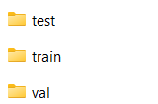
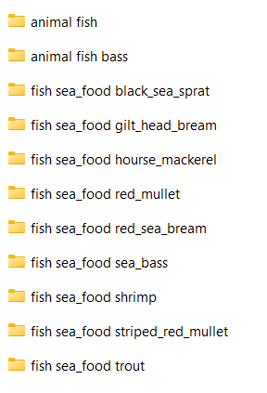
Datasets
Data Augmentation
Expanding the Dataset Creatively
A technique to artificially increase the size and diversity of your dataset by creating modified versions of existing samples.
Common methods (especially for images):
Flipping, rotation, zooming, cropping
Translation, brightness/contrast adjustment
Noise injection, blur, color jittering
Why it's needed:
Helps models generalize better to unseen data
Reduces overfitting, especially with small datasets
Simulates real-world variability without collecting new data
Improves robustness and accuracy
📌 Imagine teaching a model to recognize a fish—it should still identify it whether it's flipped, zoomed, or slightly rotated.`

Slide 6
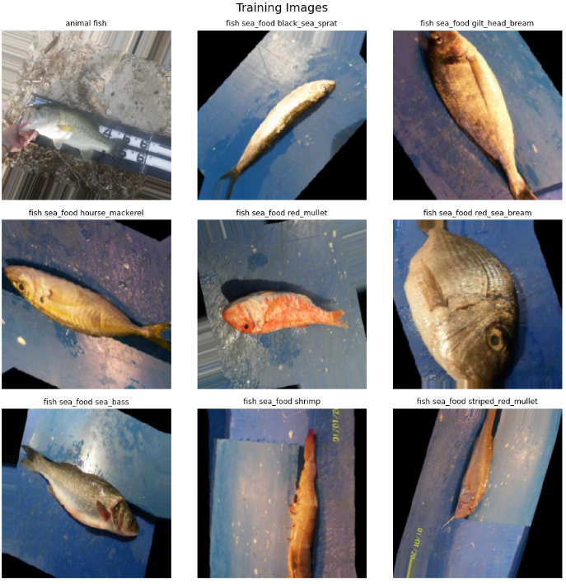
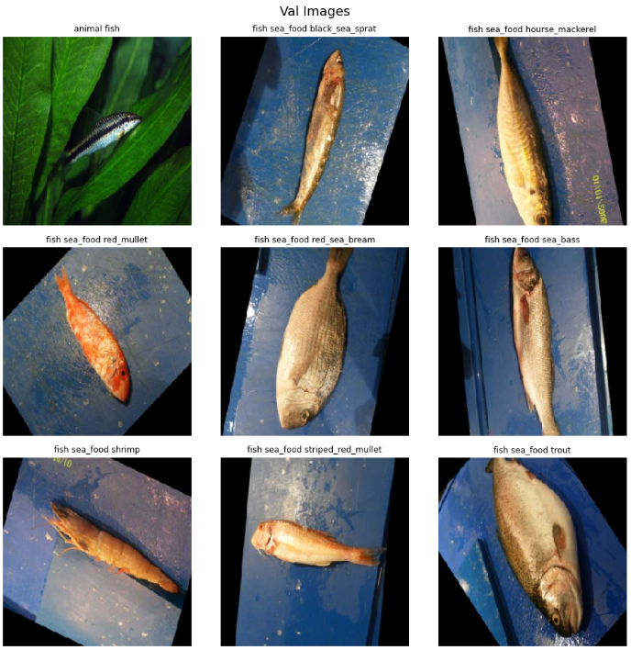
Data Pre-processing & Augmentation

Slide 7
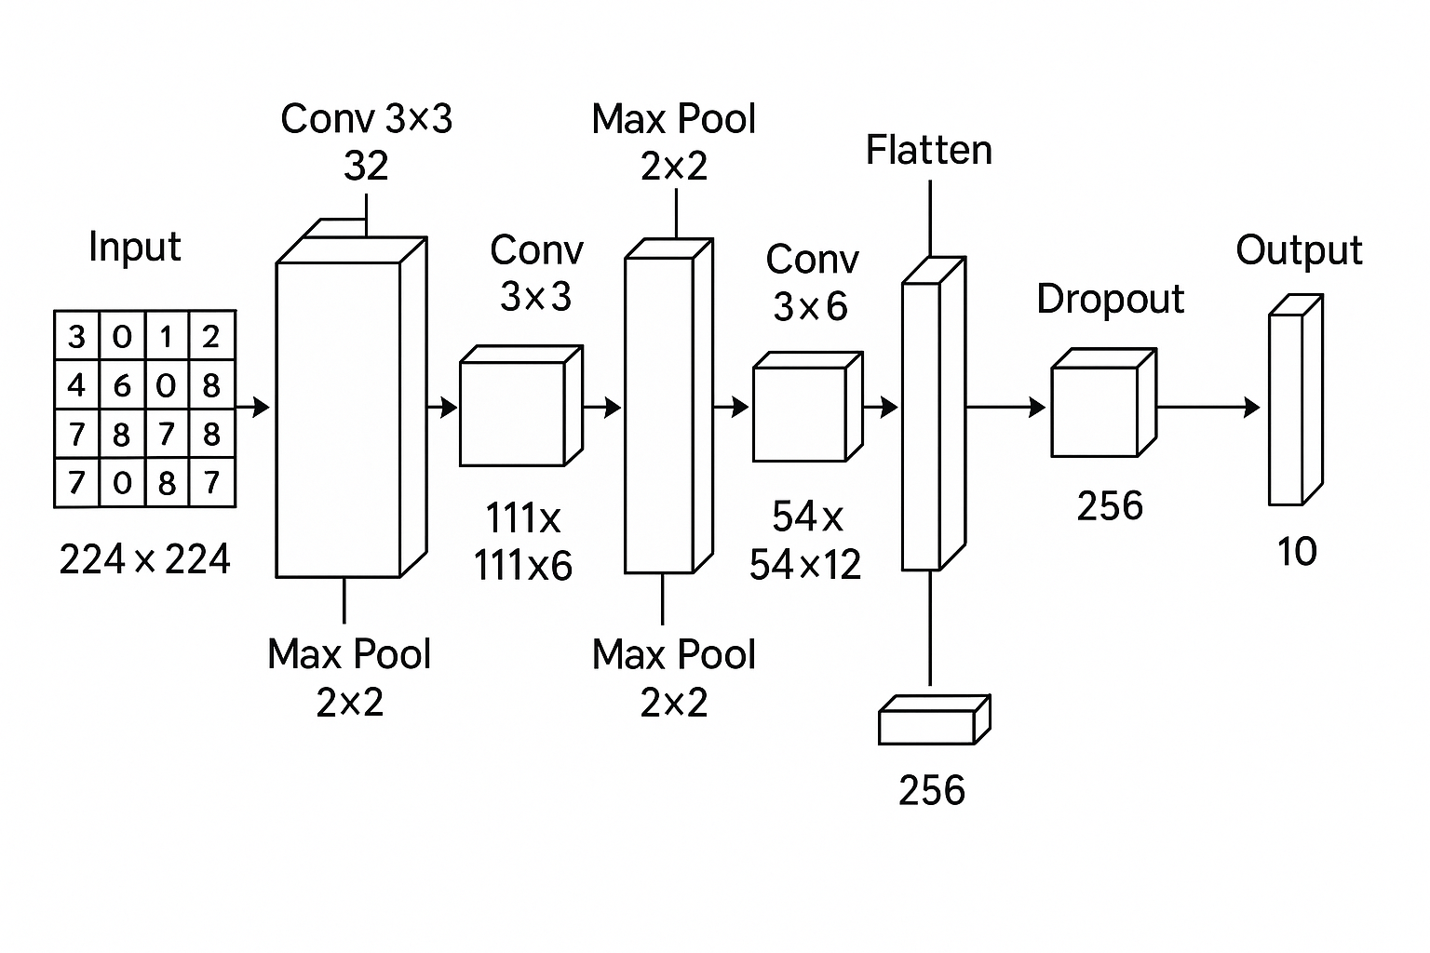
CNN Architecture Convolutional Neural Networks (CNNs) are the backbone of modern image recognition. They mimic how our visual cortex processes patterns—like edges, textures, and shapes—and learn to classify images based on those features.
Step-by-Step Process
Input Image
Treated as a matrix of pixel values (e.g., 224×224×3 for RGB images)
Convolution Operation
Filters slide over the image to detect patterns like edges or textures
Each filter produces a feature map
Activation Function (ReLU)
Applies max(0, x) to introduce non-linearity
Helps the network learn complex relationships
Pooling (Max/Average)
Downsamples feature maps (e.g., 2×2 max pooling)
Reduces computation and retains key features
Flattening
Converts pooled feature maps into a 1D vector
Fully Connected Layers
Uses learned features to classify the image
Final layer often uses Softmax to output probabilities for each class

Slide 8
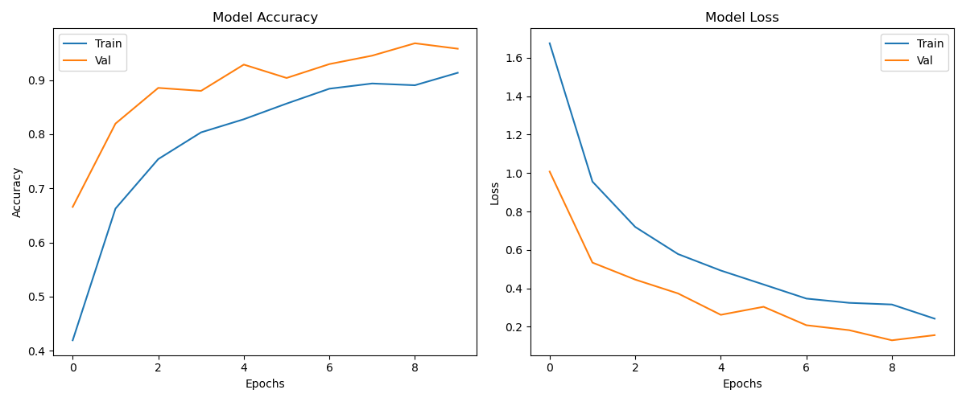
CNN Model Evaluation

Slide 9
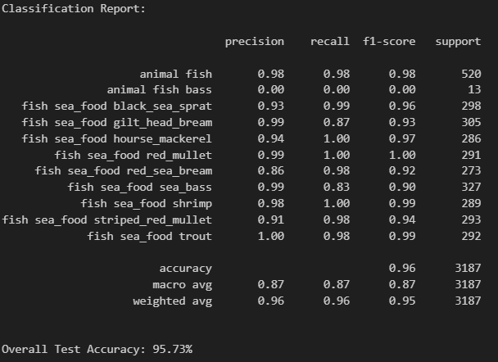
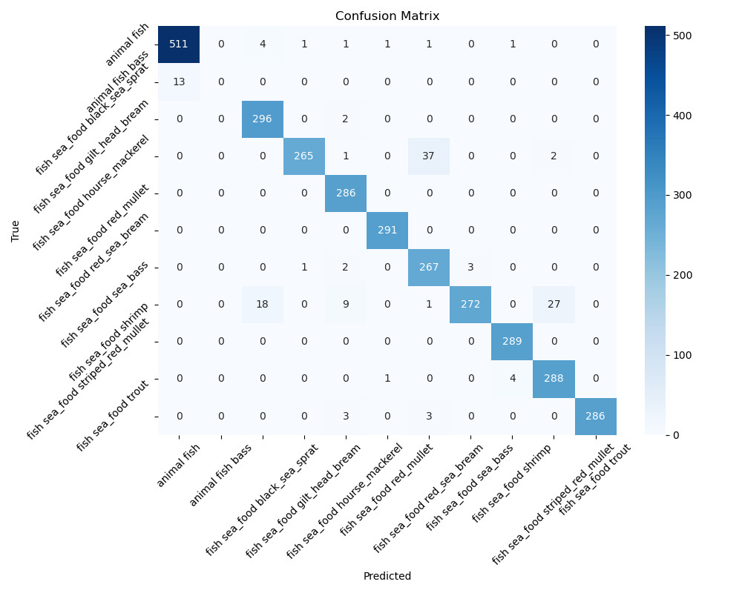
CNN Model Evaluation

Slide 10
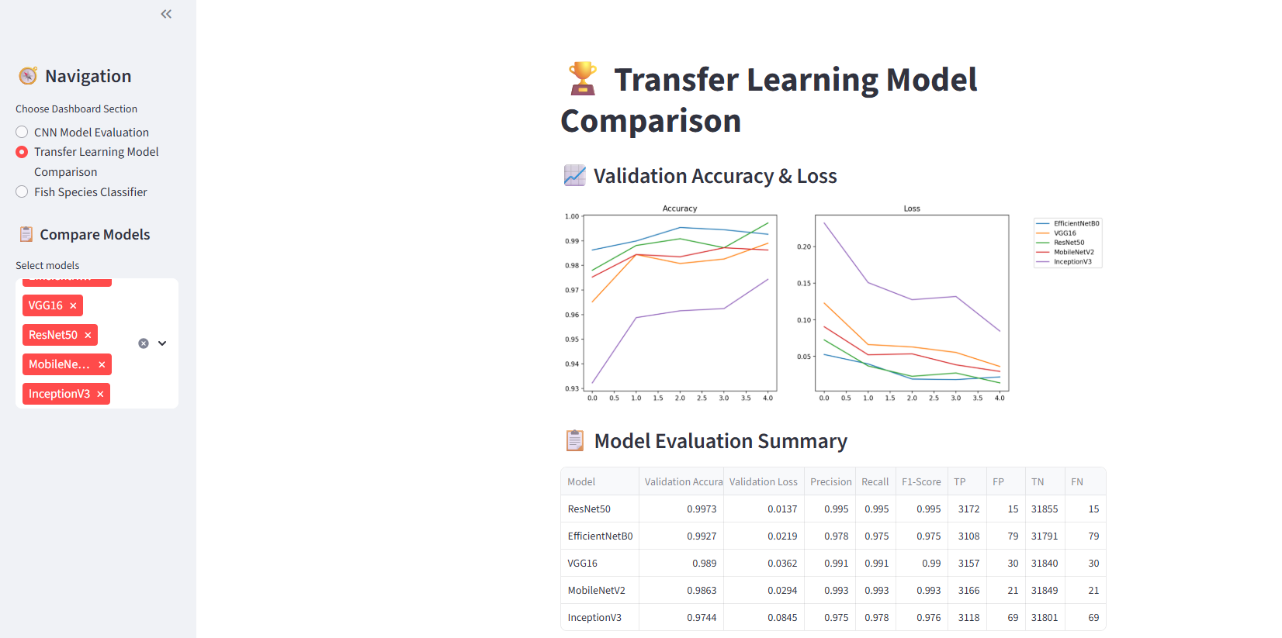
Pre-trained models & Comparison

Slide 11
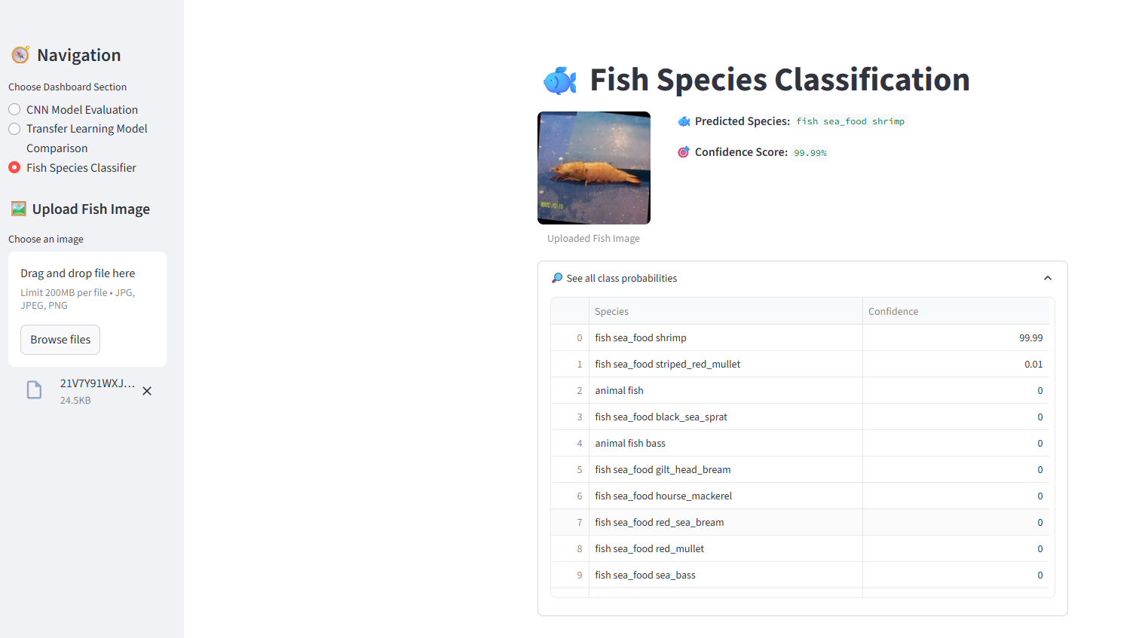
Deployment – Streamlit App

Slide 12
THANK YOU

